Slide 1

Firms and wage stagnation
Nicholas Bloom (Stanford)
(based on work with Fatih Guvenen, David Price, Ben Smith, Jae Song and Till von Wachter)
Berkeley IRLE August 26th 2016
Notes:
Inequality of income – 1% about 20%, wealth – 1% about 40%, richest 1% about 6 years longer than median

Slide 2
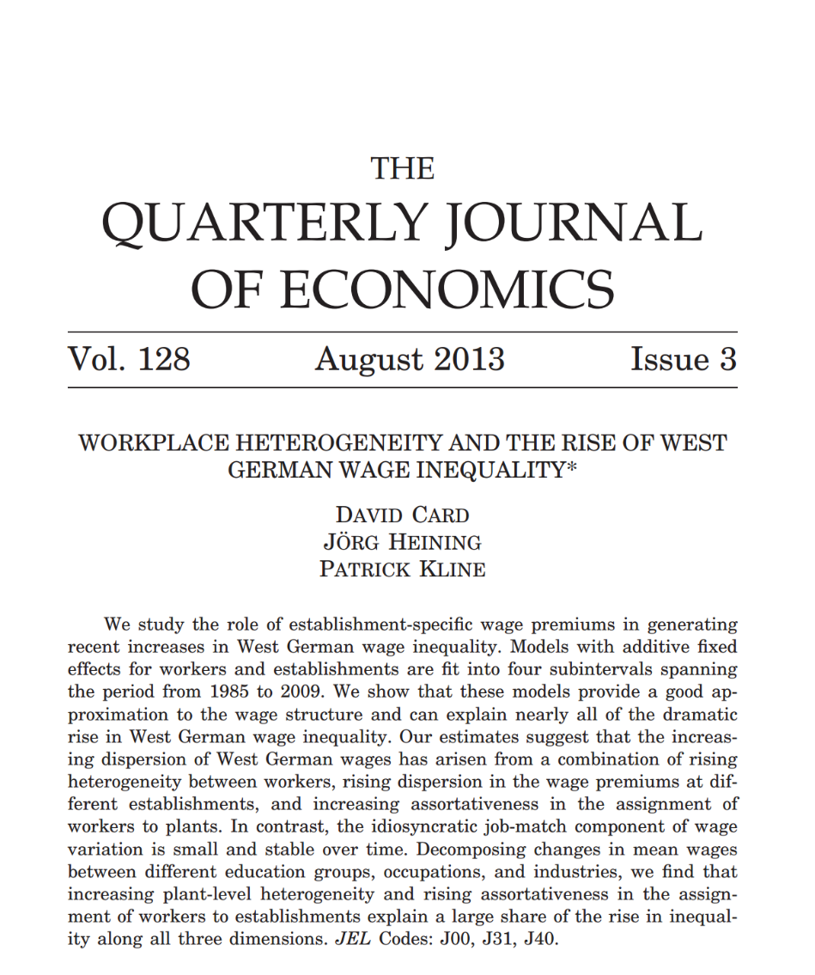
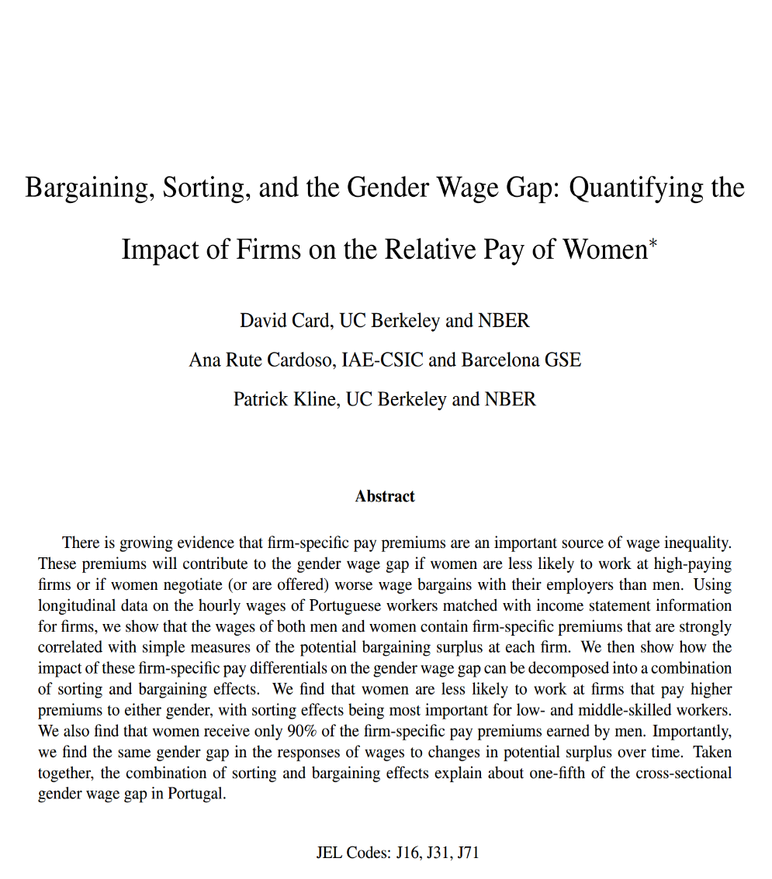
Build on David Card & co-authors work (Pat Kline, Ana Cardoso & Joerg Heining) to study the US

Slide 3
US wage inequality is a 1/3 - 1/3 - 1/3 story
Between firms accounts for ≈2/3 of increasing inequality
1/3 from rising segregation (increased variance of high AKM fixed-effect workers across firms)
1/3 from rising sorting (increased covariance of AKM worker fixed-effects and firms fixed-effects)
Within firms accounts for ≈ 1/3 of rising inequality
Mainly in large firms, and appears most workers slowly losing the large-firm wage premium (except for the top 0.5 to 1%)
Notes:
Moore (1911)

Slide 4
Outline
Data: SSA, Census (LBD) and CPS
Between firms (Firming up inequality) – the 2/3
Within firms (Shrinking large-firm wage premium) – the 1/3

Slide 5
SSA Data is the Master Earnings File (MEF)
Universe of all W-2s from 1978 to 2013
For each job: SSN, EIN and total compensation:
“Total compensation includes: wages, salaries, tips, restricted stock grants, exercised stock options, severance payments, & all other types of income considered remuneration for labor services by the IRS.”

Slide 6
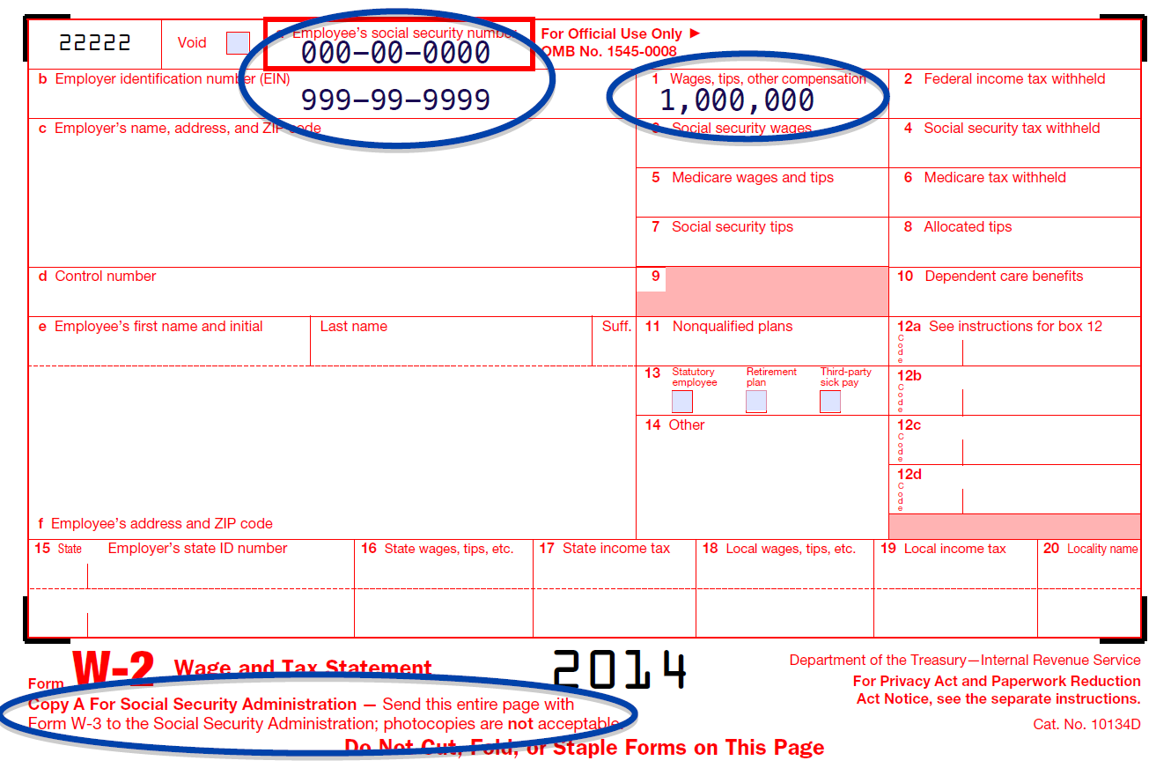
Example W2

Slide 7
Outline
Data: SSA, Census and CPS
Between firms (Firming up inequality) – the 2/3
Within firms (Shrinking large-firm wage premium) – the 1/3

Slide 8
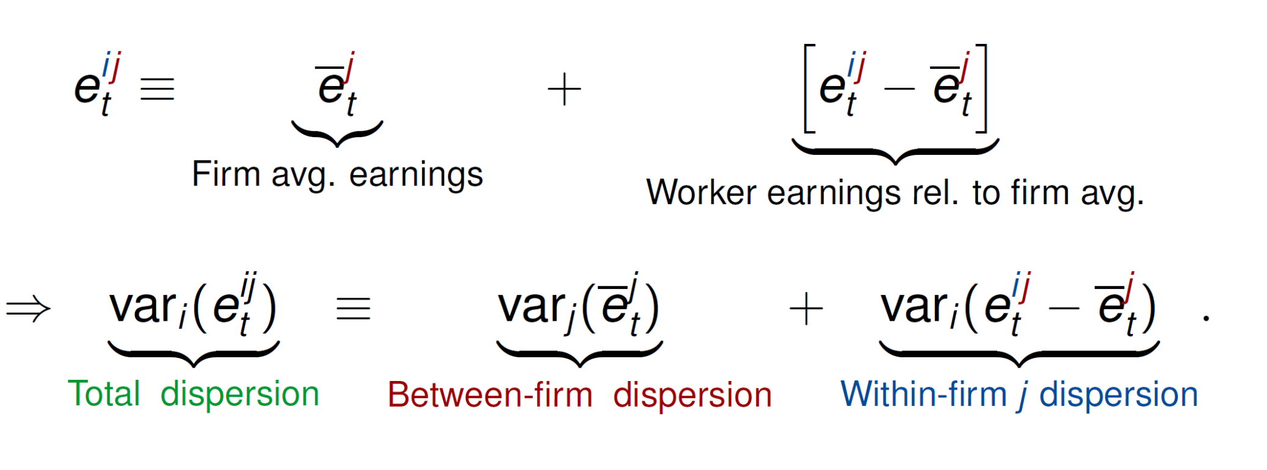
1. Decomposition of Variance

Slide 9
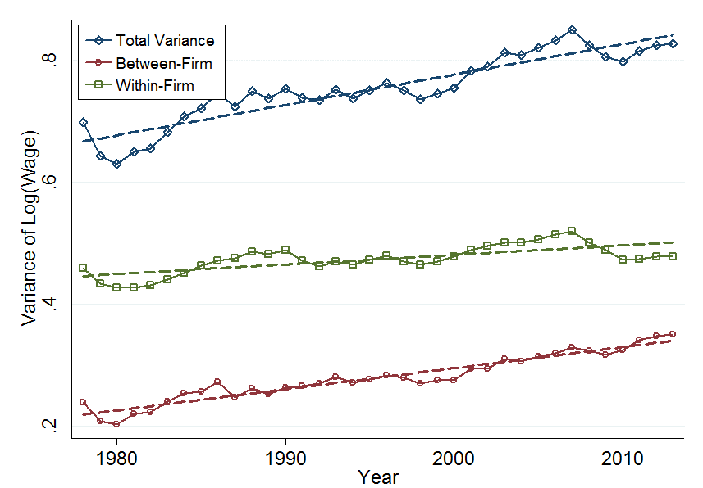
Decomposition of Variance – about 2/3 of increase is between firms

Slide 10
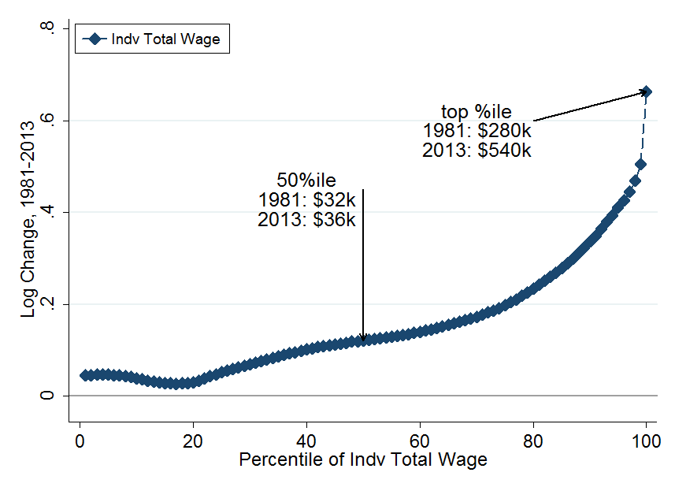
3. The cross-sectional change 1981-2013
Note: Change in average log real annual pay for individuals in each percentile

Slide 11
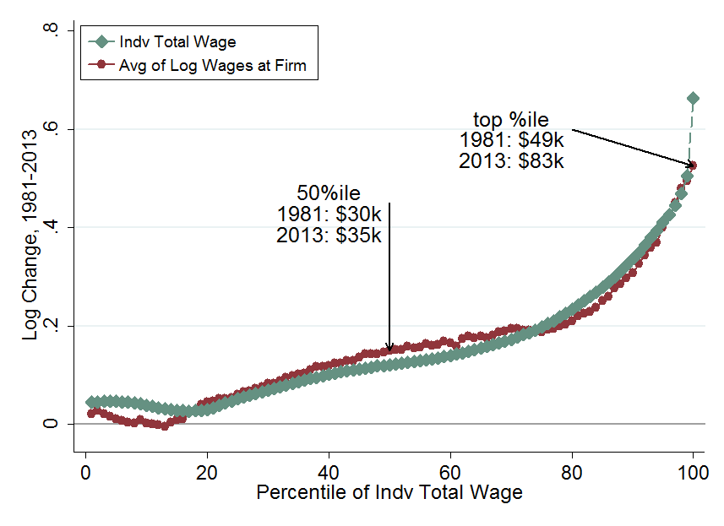
3. The cross-sectional change 1981-2013
Note: Change in average log real pay for firms employing individuals in each percentile

Slide 12
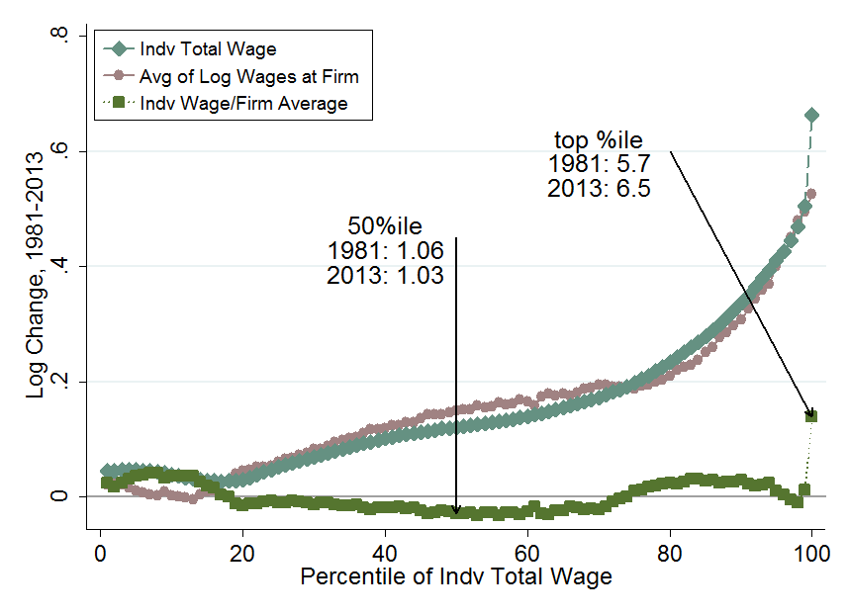
3. The cross-sectional change 1981-2013

Slide 13
Robustness: different sub-groups look similar
Location (region and county)
Plants or firms
Gender
Age
Industry (SIC 1-digit and SIC 4-digit average)
Continuing firm
5-year earnings
Minimum earnings cutoff
Benefits (Healthcare)

Slide 14
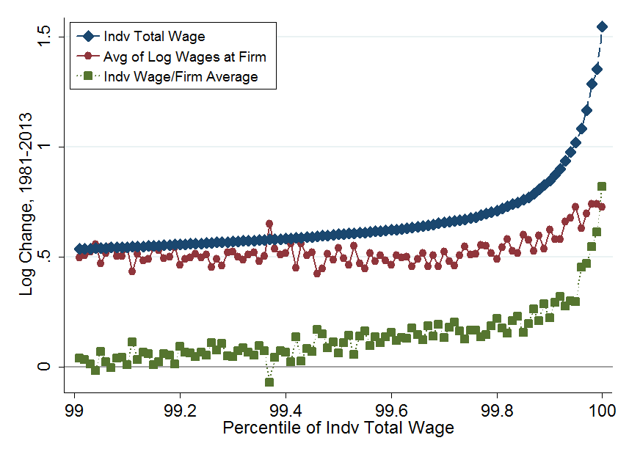
Zooming in on the top 0.5%
+370%
+125%
+110%

Slide 15
Analysis with the Abowd, Kramarz and Margolis (1999) and Card, Henning and Kline (2013) Model
Statistical Model for Individual Log Annual Earnings
Fixed worker component α (e.g. education, innate ability, etc.)
Fixed firm component Ψ (e.g. rent sharing, efficiency wages, etc.)
Time varying worker characteristics (here age and age squared)
Estimate Separately in 7-Year Intervals from 1980 to 2013
1980-1986 (first): 5.2m firms, 65m workers, 332m worker years
2007-2013 (last): 5.2m firms, 81m workers, 414m worker-year
Notes:
PSI

Slide 16
Decompositions of Variance in Earnings
Ignoring individual characteristics (X terms) we can write
where captures deviation pay from firm mean
Segregation
Sorting
Firm variance

Slide 17
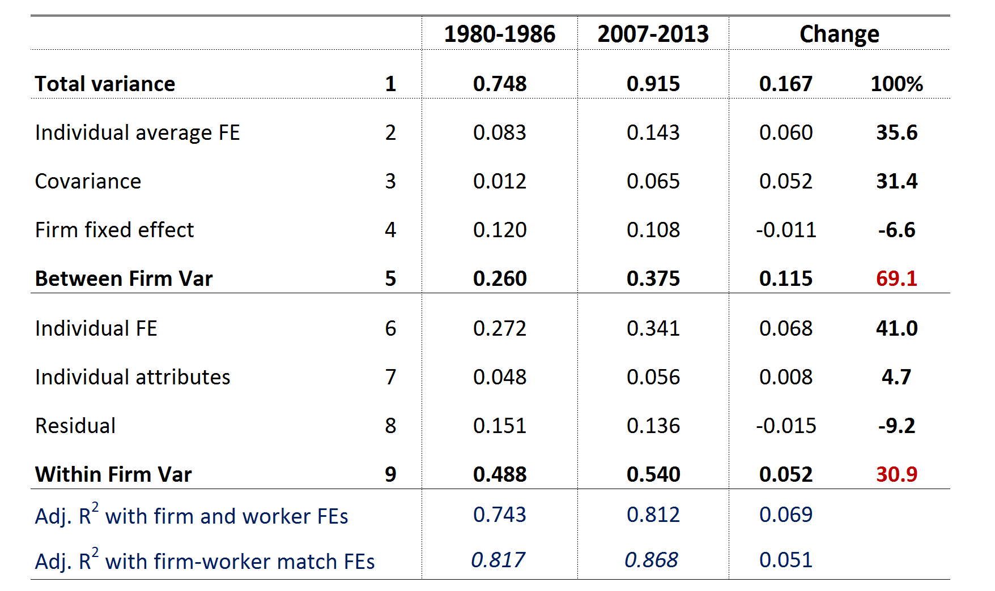
Results for changes in variance
Note: Only the major terms are shown

Slide 18
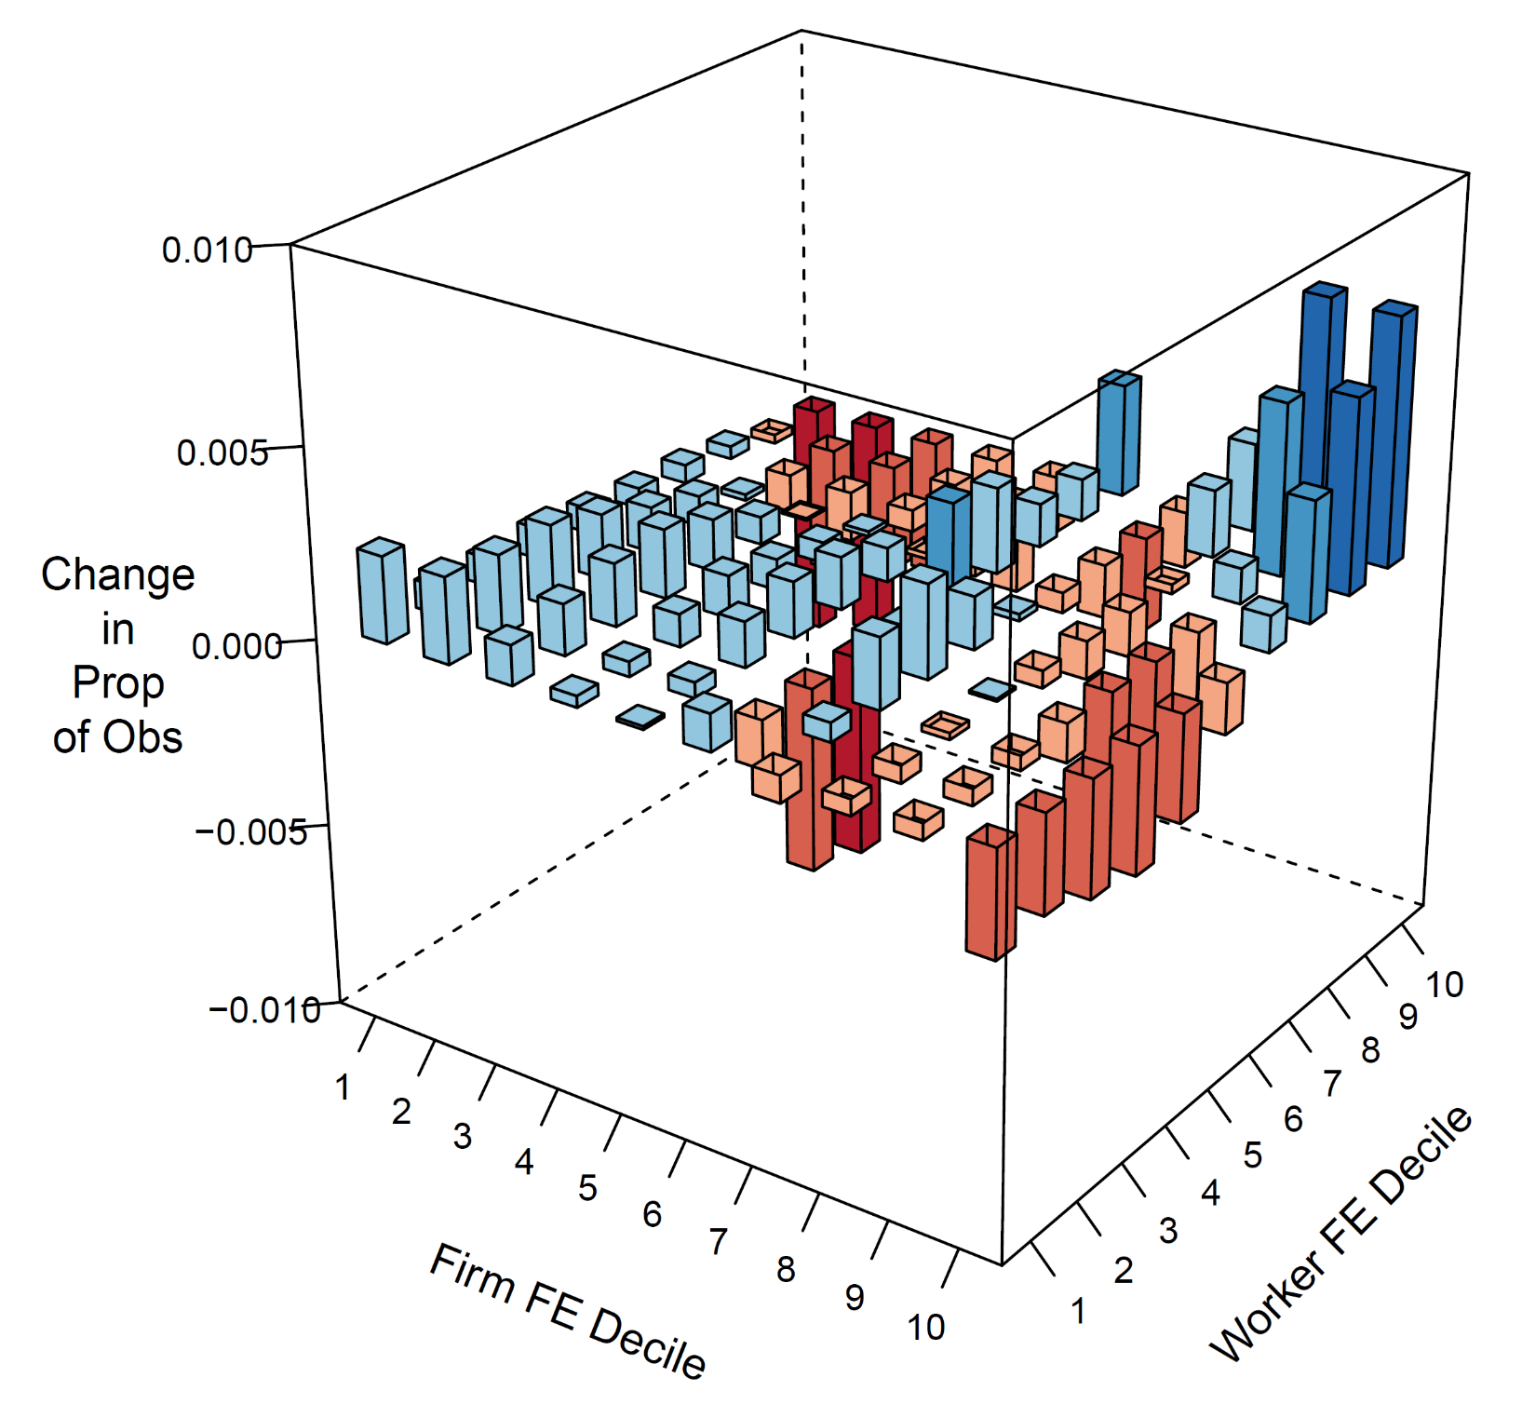

Rising sorting in graphics
Change in proportion of observations
(1980-1986 to 2007-2013)

Slide 19

Why – not clear? One driver is firm reorganization around “core competencies” aided by outsourcing

Slide 20






The story as a one firm example – GE, which has had about 300k employees since the 1960s
Catering & facilities
outsourced
Security
IT services
HR
Real estate
Notes:
Gary Hamel and CK Prahalad introduced idea of core competency in an 1990 HBR article

Slide 21
Matches rising occupational, educational and skill segregation in firms
Handwerker (2016) shows rising US occupational segregation in establishments (and EIN firms) since 2000.
See rising segregation in other measures and countries:
Card, Henning and Kline (2013): education and occupation
Barth, Bryson, Davis and Freedman (2014): education
Hakanson, Lindqvist & Vlachos (2015): cognitive skills

Slide 22
Outline
Data: SSA, Census and CPS
Between firms (Firming up inequality) – the 2/3
Within firms (shrinking large-firm wage premium) – the 1/3

Slide 23
Rising within firm inequality has occurred almost entirely within large firms
The share of rising inequality within firms is ≈ 30% overall
It is only 14% in firms with <10k employees, and only 6% in firms <1k employees

Slide 24
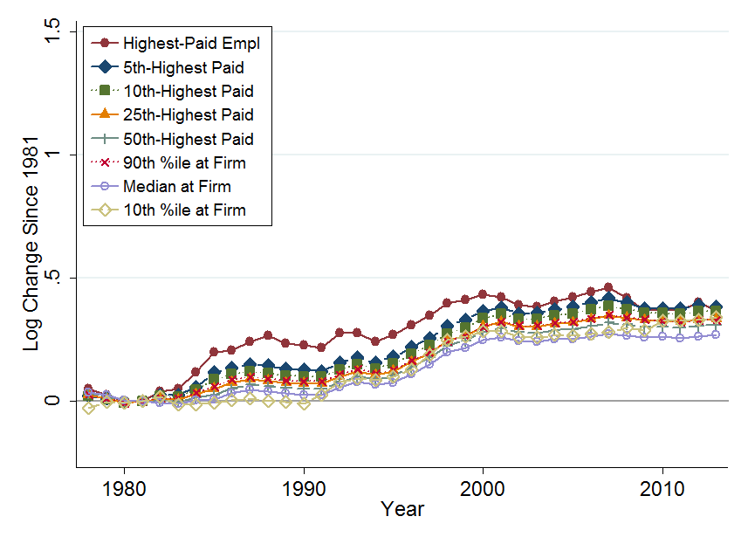
Firms 100≤employees<1k, percentiles since 1981
+45%
+31%

Slide 25
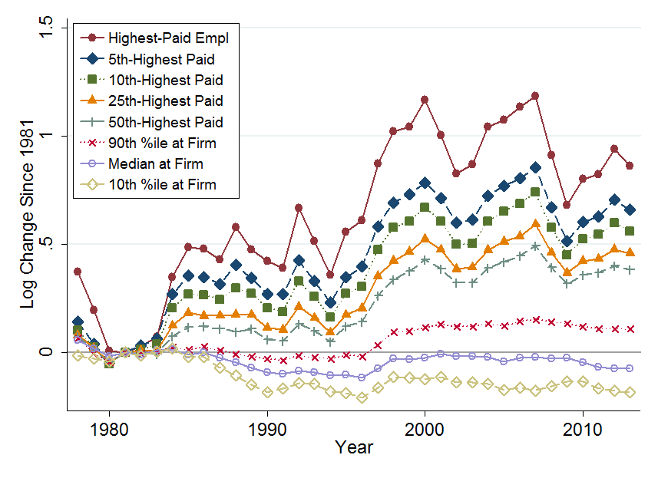
Firms 10k≤employees, percentiles since 1981
+137%
+45%
-7%

Slide 26
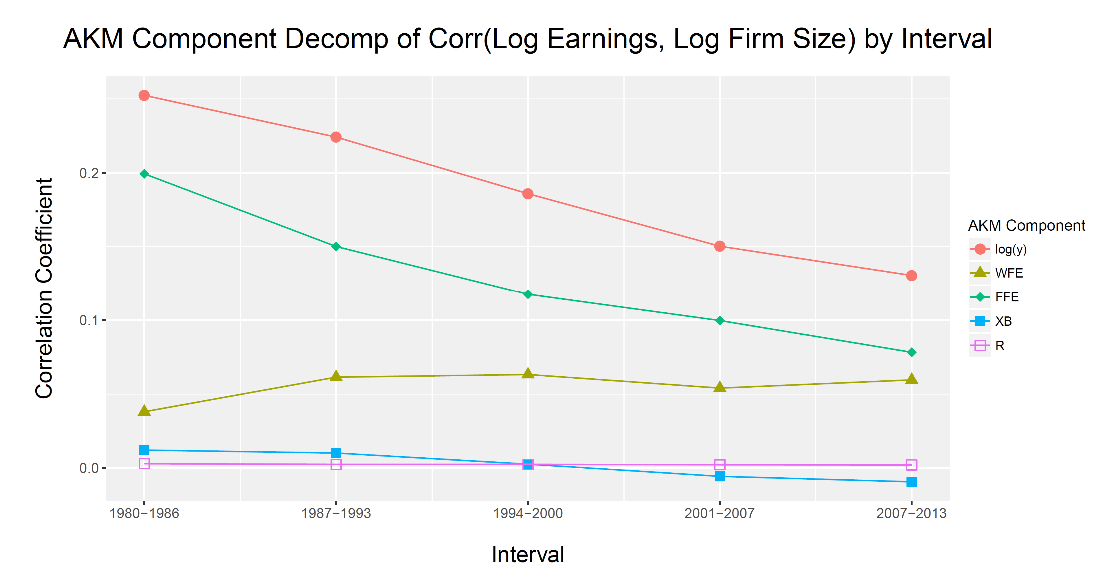
The bottom end is the disappearing large firm wage premium

Slide 27
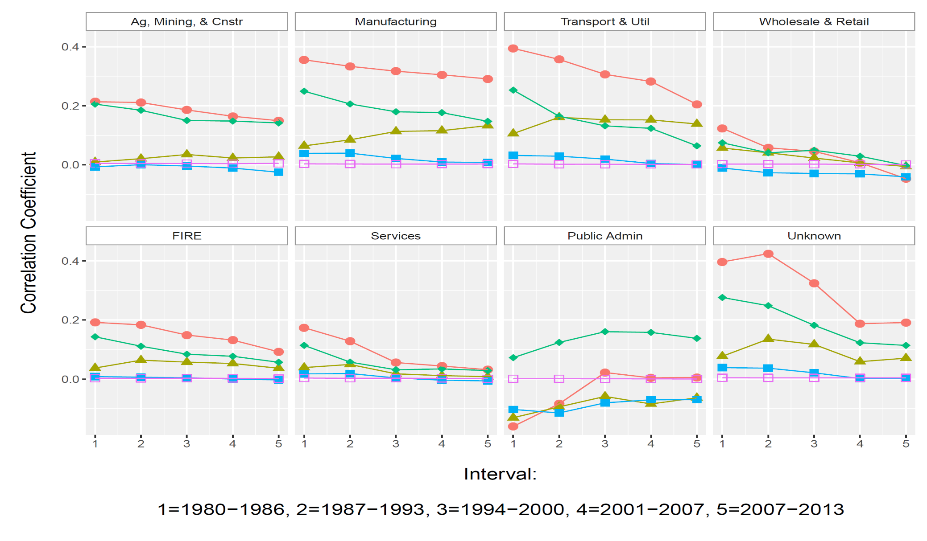


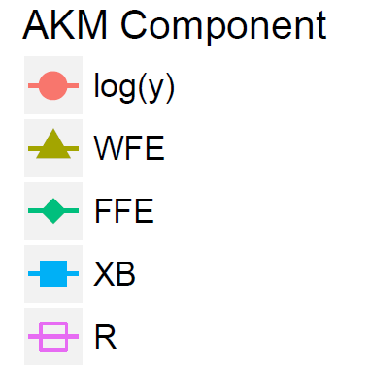
About half of this is industry compositional change

Slide 28
Conclusions
As David has long said firms appear to play an important role in shaping inequality
They directly account for around 2/3 of rising inequality, 1/3 from sorting which raises overall inequality
The remaining 1/3 of rising inequality is within larger firms, with most workers see declining pay (except the top 0.5%)

