Slide 1
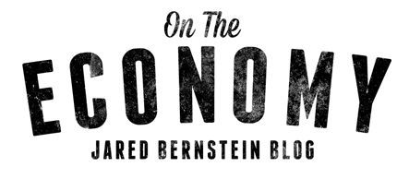
Macro-conditions, slack, and wages
Jared Bernstein
bernstein@cbpp.org
IRLE/Equitable Growth conference on the causes of wage stagnation
Berkeley University
August, 2016

Slide 2
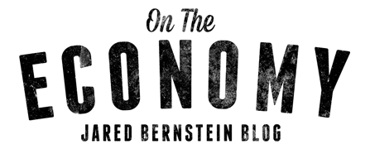
Key points
Slack hurts both nominal and real wage growth through both hourly wage and hours-worked channels.
Job market slack has been the norm in recent decades.
Full employment is progressive.
The max employment/price stability relationship is highly uncertain.
How do we get to and stay at full employment?

Slide 3
Theories of wage determination
Two bins: Those that assume full emp and those that don’t.
Assume full emp:
Marginal product, micro
Productivity, macro (cyclical comp share at odds with full emp assumption)
Do not assume full emp (more compelling, given evidence):
Search theory
Efficiency wage theory
Institutionalist theories/bargaining power/cycle
“Wage curves”
Phillips price wage curve

Slide 4
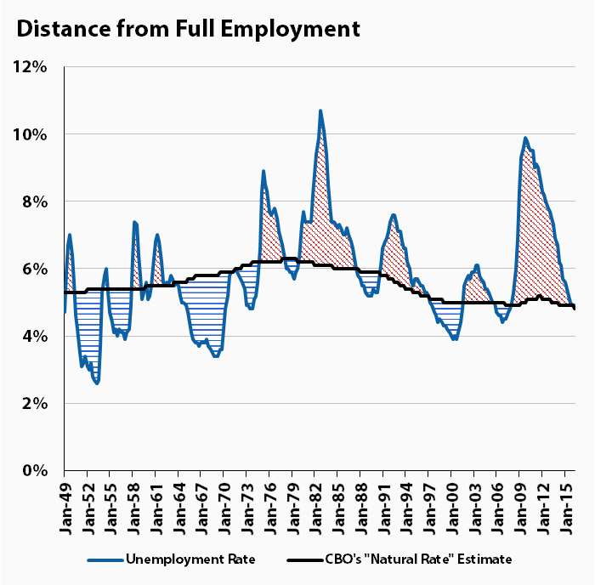
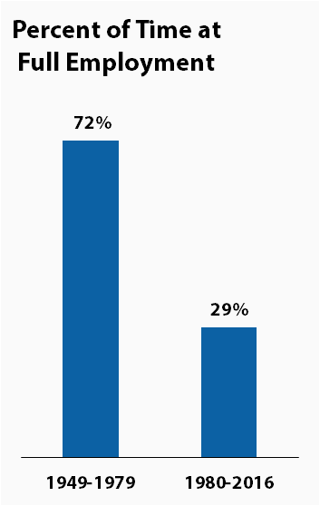
Slack attack!

Slide 5
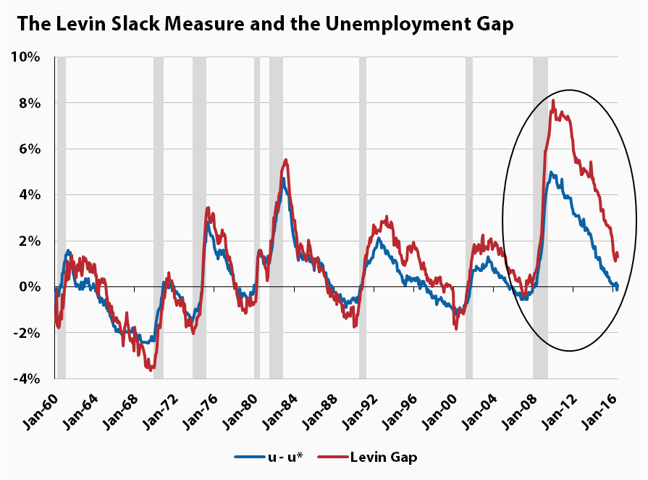
A more refined slack metric?

Slide 6
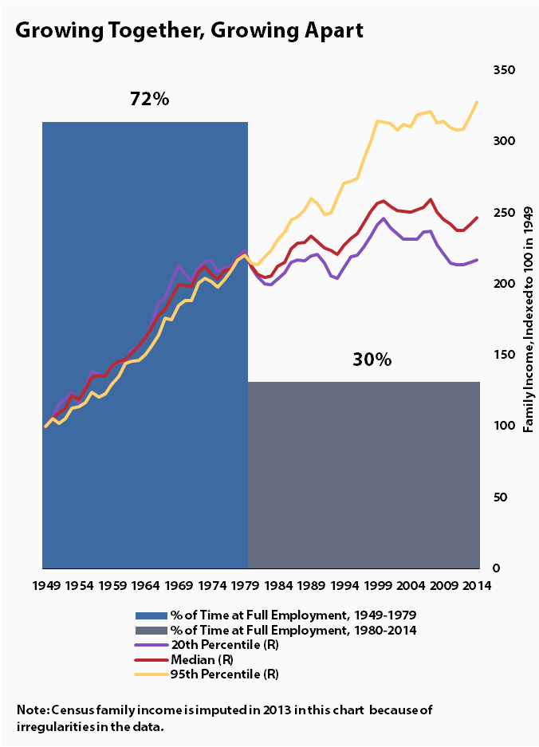
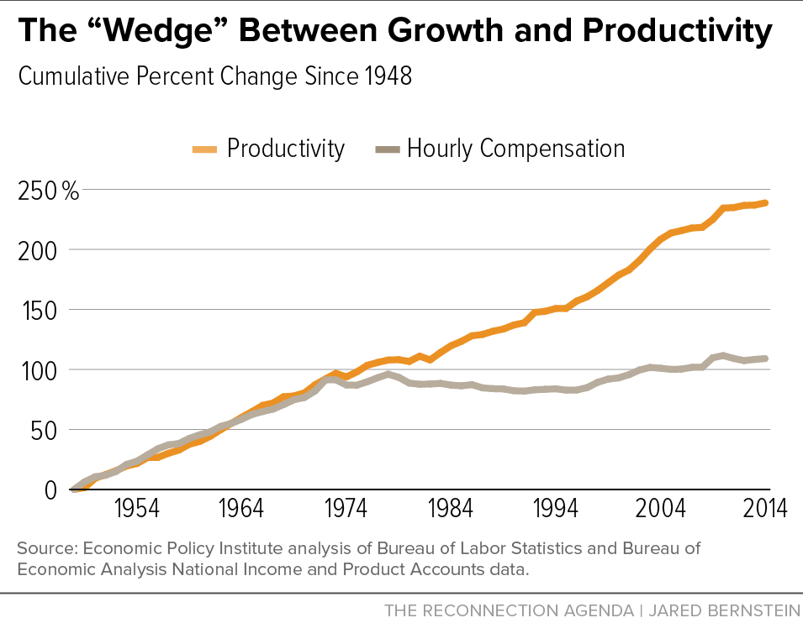

Slide 7
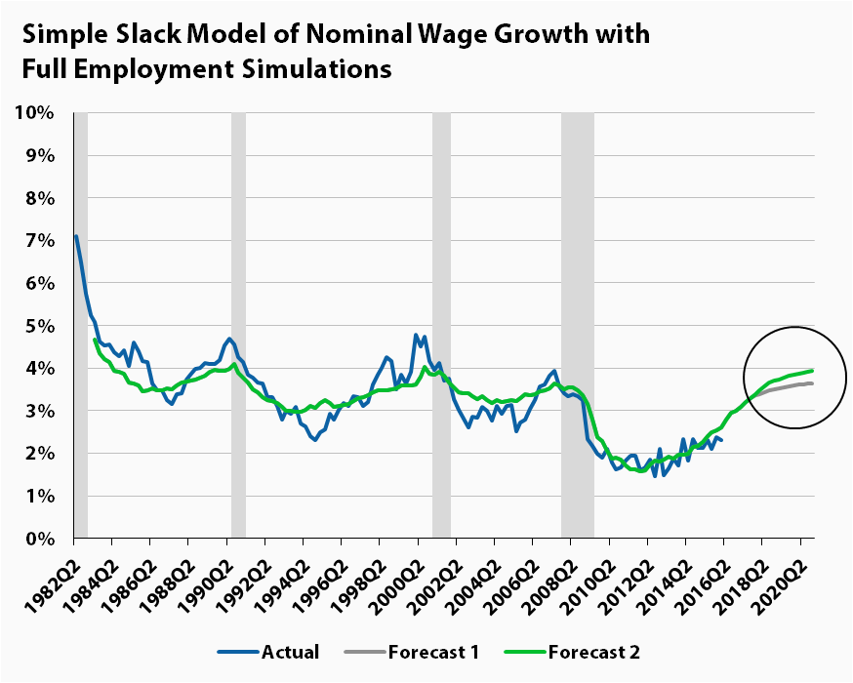

Slide 8
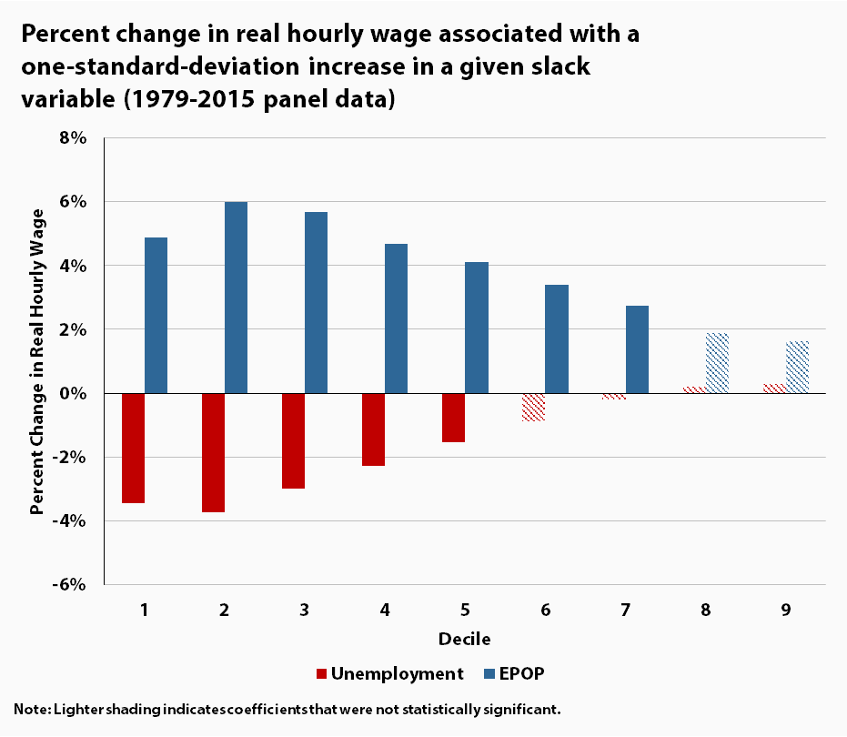

Slide 9
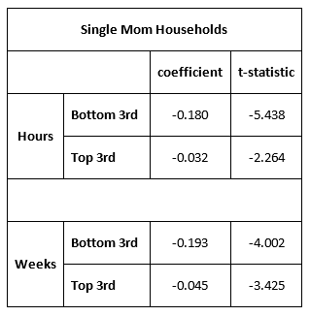
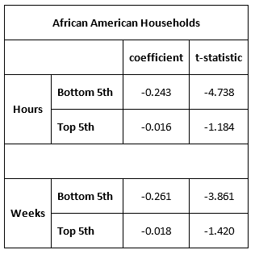

Slide 10
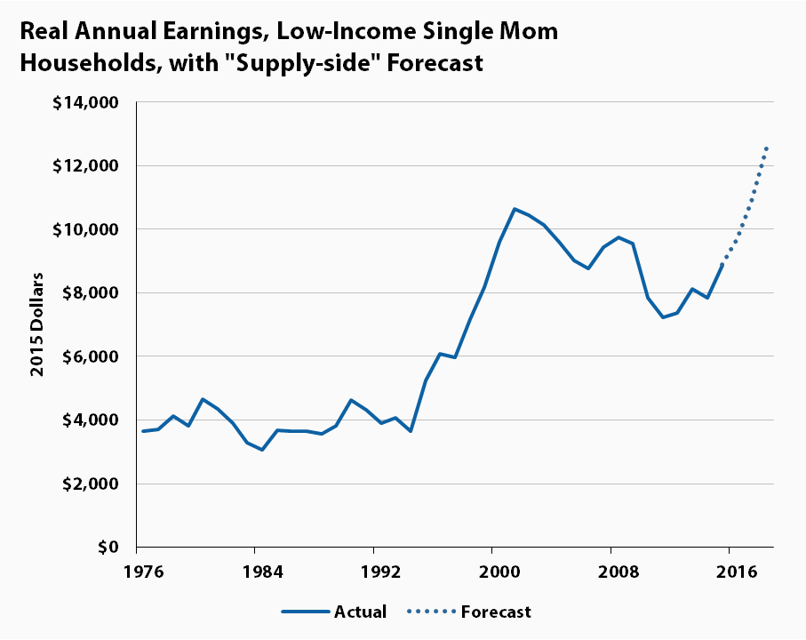
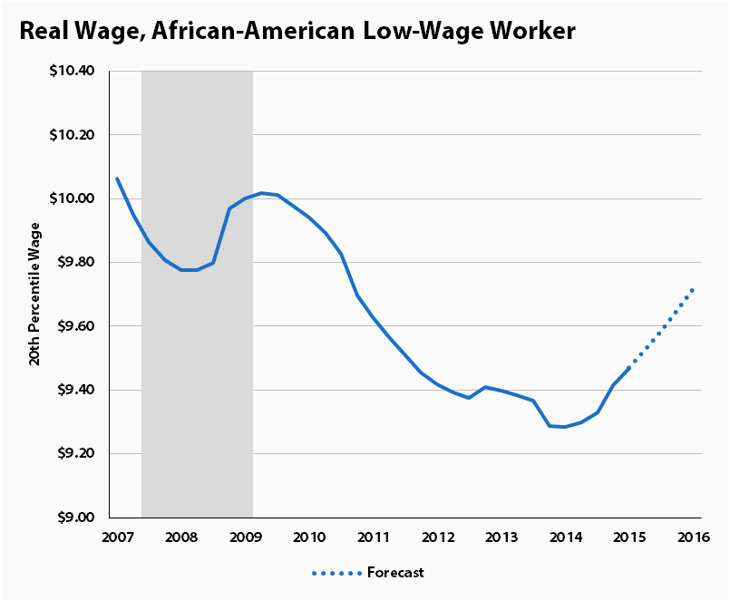

Slide 11
Collecting facts…
Full emp is:
--too rare
--one cause of wage stagnation (i.e., its absence)
--progressive
So, why not put the policy-pedal to the metal and just get there…and stay there, right? I.E., who’s against full employment, right?

Slide 12
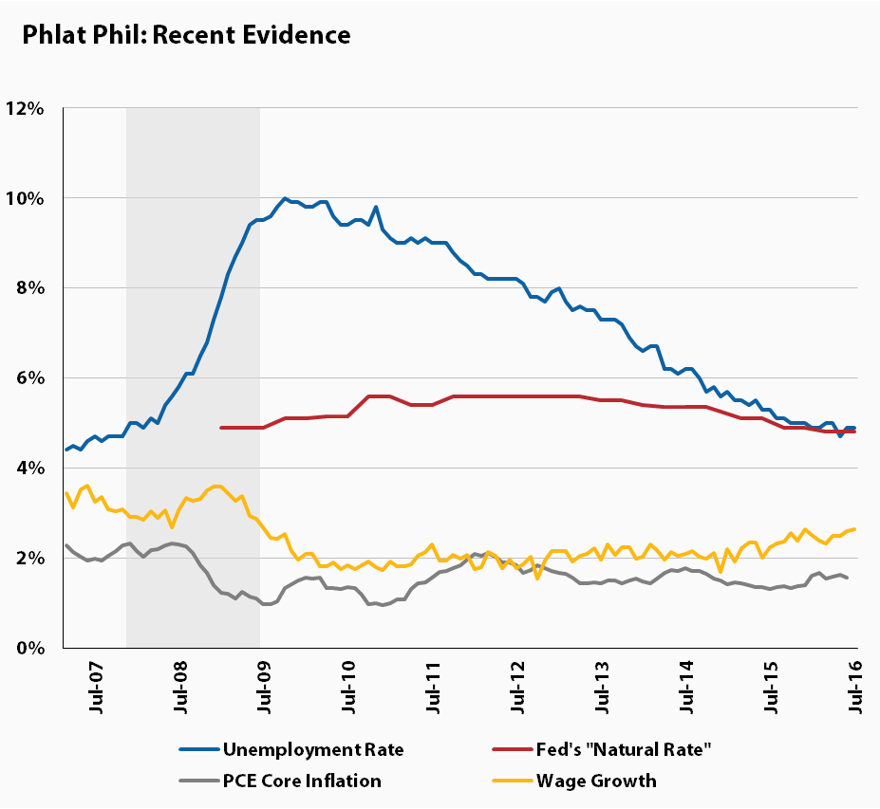
Full emp/Inflation tradeoff: the Phillips Curve

Slide 13
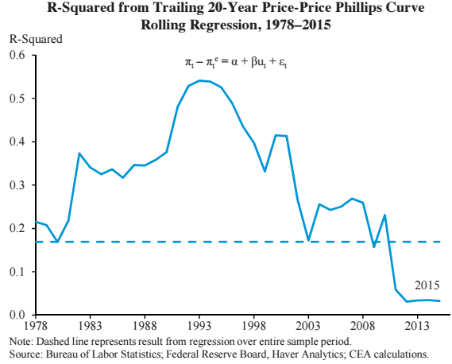
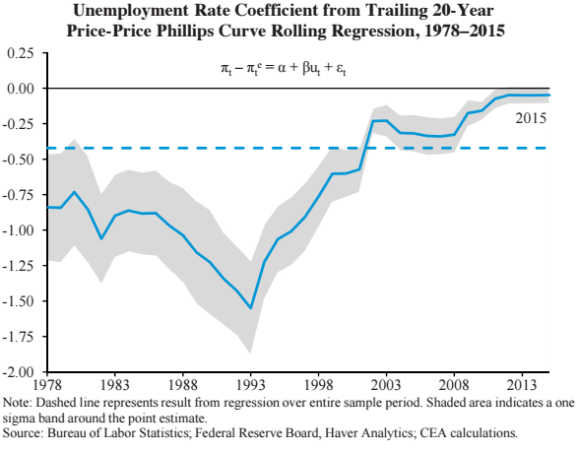
ERP Evidence: Very important source

Slide 14
Natural rate ranges from 0 to 6 percent!

Slide 15
Implications of Phlat Phil
Fed faces asymmetric risk
Usual guideposts not reliable
Macro problems, like secular stagnation (and thus “low perch” to fall from in next downturn)
Some plausible work identifies/explains PC

Slide 16
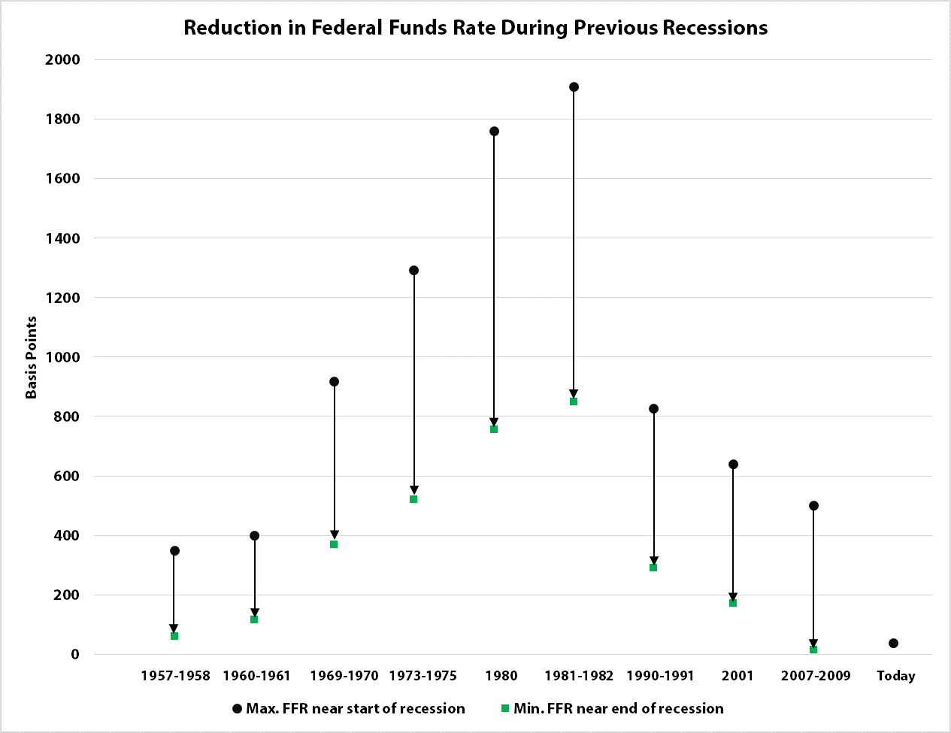

Slide 17
Getting to full employment
Trade deficit
Monetary and fiscal policy
Those beyond its reach: deep poverty, criminal justice, neighborhood effects
Financial market oversight

Slide 18
Full emp and the election
The good news: It’s in the D’s platform!
“…we are committed to doing everything we can to build a full-employment economy, where everyone has a job that pays enough to raise a family and live in dignity with a sense of purpose.”
The bad news: Platforms don’t mean much
The other bad news: Congressional gridlock; anti-Keynesianism; unrepresentative, money-infused politics; inflation hawks; deficit hawks.
But none of these are a match for our FEP.

Slide 19
If you’re with me, I need your help!

Slide 20
Jared Bernstein
bernstein@cbpp.org
jaredbernsteinblog.com
Notes:
Thank you!

